Slide 1
PHONIC DRILL

Slide 2

WHAT IS MOTHER TONGUE INFLUENCE
Mother tongue influence (MTI) is an impact of your first language on your second language. When you speak the second language, you can see how effective the mother tongue can be.

Slide 3

How to overcome MTI
Use of tongue twisters
Improve your pronunciation
Active conversations with your peer in second language
Learning new words daily with right meaning
Think in English instead of mother tongue
Reading books written in second language
Watching movies in second language and with subtitles

Slide 4
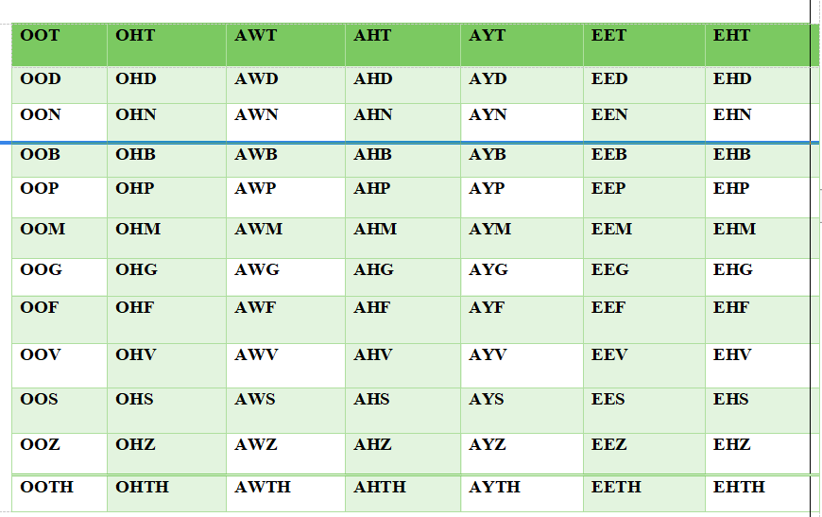

Slide 5
Sounds of /f/ and /v/
Belief believe
Fail veil
Fear veer
Feel veal
Fender vendor
Grief grieve
Staff starve
Surf serve
Fast vast
Fine vine
Foul vowel
Gif give
Half halve
Life live
Proof prove
Safe save

Slide 6
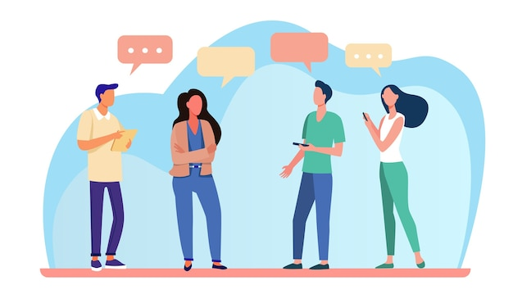
Let’s practice
Favourite
Forgive
Lifesaver
Knives

Slide 7
Sounds of /s/ and / ʃ/
Sea she
Seat sheet
See she
Sock shock
Sort Short
Save shave
So show
Sofa chauffeur
Sore sure

Slide 8
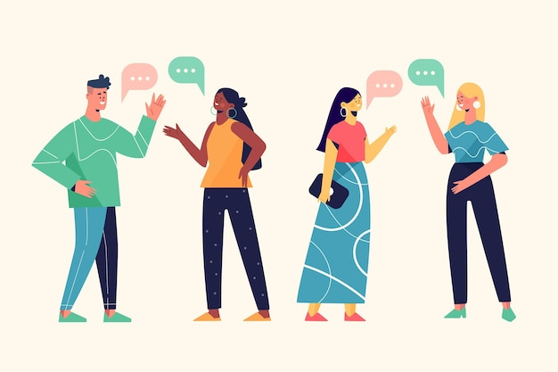
Practice time
Parcel
Partial
Sheath
Sharpen

Slide 9
Sounds of /f/ and /θ/
free three
Deaf
death
Fought thought
Fin thin
thirst
Froze throws

Slide 10

Practice time
Through
Furred
Frivolous
froth
Theosophical

Slide 11
Sounds of /ʤ/ and /z/
siege sees
Stage stays
Wage ways
Wodge barge
Change chains
Charge chars
Forge fours
Fridge frizz

Slide 12

Practice time
Siege
strains
gorge
Gauge

Slide 13
Pronounce these words
-Almond (/ɑːmənd/)
Incorrect: al-muh-nd
Correct: ah-muh-nd
-Accessory (/əkˈsesəri/)
Incorrect: ah-seh-suh-ree
Correct: uhk-seh-suh-ree
-Cache (/kæʃ/ )
Incorrect: kash-ay
Correct: kash
-Coupon (/kuːpɒn/)
Incorrect: que-pun
Correct: koo-pon

Slide 14
-Espresso (/eˈspresəʊ/)
Incorrect: e-xpres-oh
Correct: e-spres-oh
Hyperbole (/haɪˈpɜːbəli/)
Incorrect: hahy-pur-bowl
Correct: hahy-pur-buh-lee
-Itinerary (/aɪˈtɪnərəri/)
Incorrect: ahy-tin-ary
Correct: ahy-tin-uh-rer-ee
-Jewellery (/dʒuːəlri/)
Incorrect: joo-el-er-y
Correct: joo-uh l-ree
-Pronunciation (/prəˌnʌnsɪˈeɪʃn/)
Incorrect: pruh-noun-see-ey-shuh n
Correct: pruh-nuhn-see-ey-shuh n

Slide 15

How MTI looks like
“iskool” “School”
“see” “she”
“phonts” “fonts”
“jeero” “zero”
“plezar” “pleasure”

Slide 16
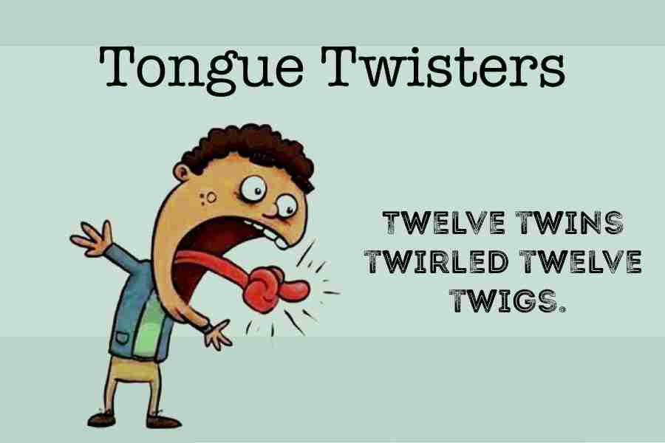
TONGUE TWISTER
A tongue twister is a phrase or sentence that is difficult to articulate, often due to the presence of a sequence of similar sounds.

Slide 17
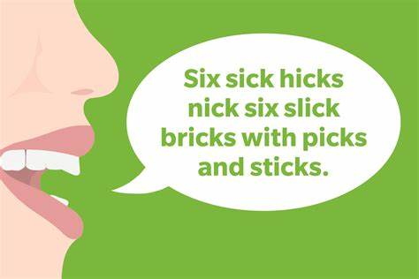
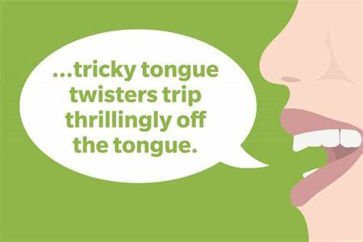
Tongue twisters with
/s/ & /t/

Slide 18
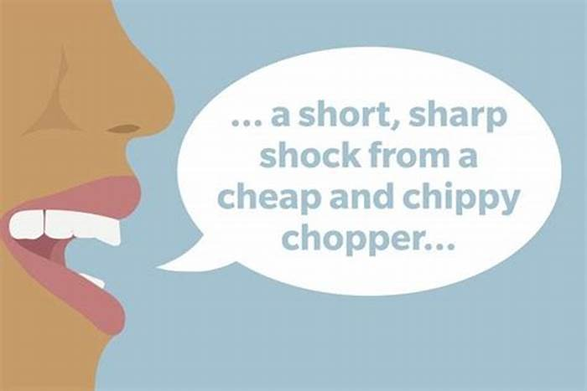

Tongue twisters with
/ch/ & /sh/
/th/

Slide 19
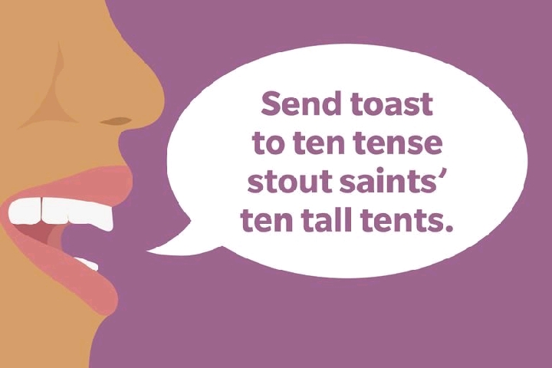
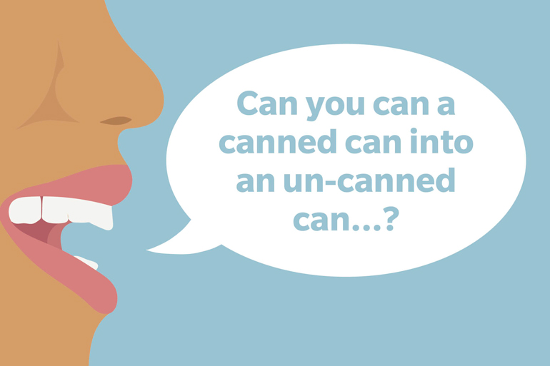
Tongue twisters with
/s/ & /c/

Slide 20
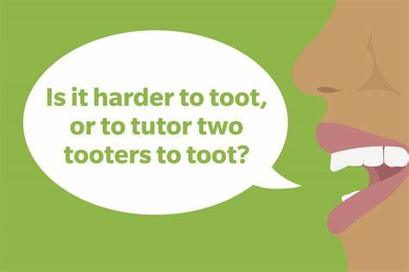

Tongue twisters with
/t/ & /s/sh/

Slide 21
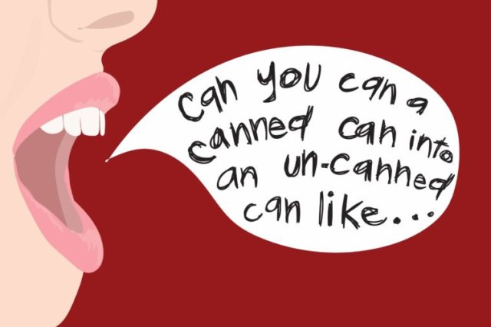
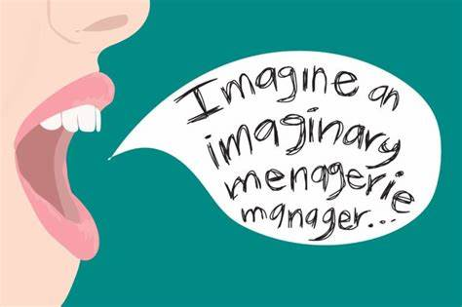
Tongue twisters with
/c/ & /i/

Slide 22
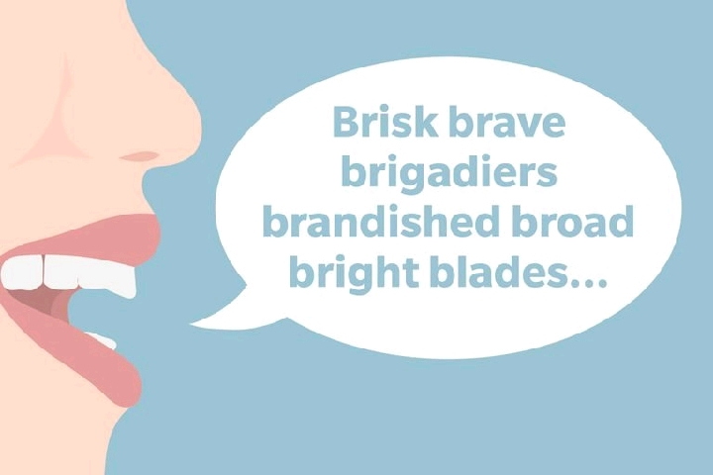
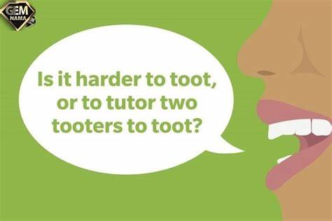
Tongue twisters with
/b/ & /t/

Slide 23
Tongue twisters with
/f/ & /p/
Fuzzy Wuzzy was a bear. Fuzzy Wuzzy had no hair. Fuzzy Wuzzy wasn’t very fuzzy, was he Fuzzy Wuzzy was a bear. Fuzzy Wuzzy had no hair. Fuzzy Wuzzy wasn’t very fuzzy, was he
Peter Piper picked a peck of pickled peppers. A peck of pickled peppers Peter Piper picked.

Slide 24
Tongue twisters with
/sk/th/st & /r/w/
A skunk sat on a stump and thunk the stump stunk, but the stump thunk the skunk stunk.
Rory the Warrior and Roger the Worrier were reared wrongly in a rural brewery.

Slide 25
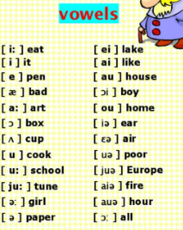

Slide 26
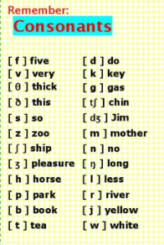

Slide 27
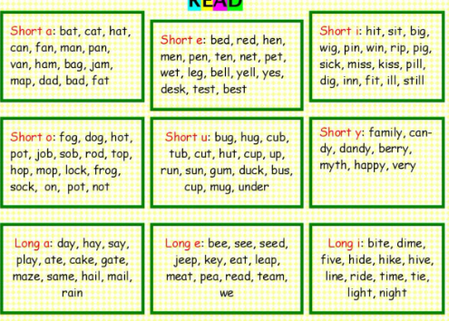

Slide 28
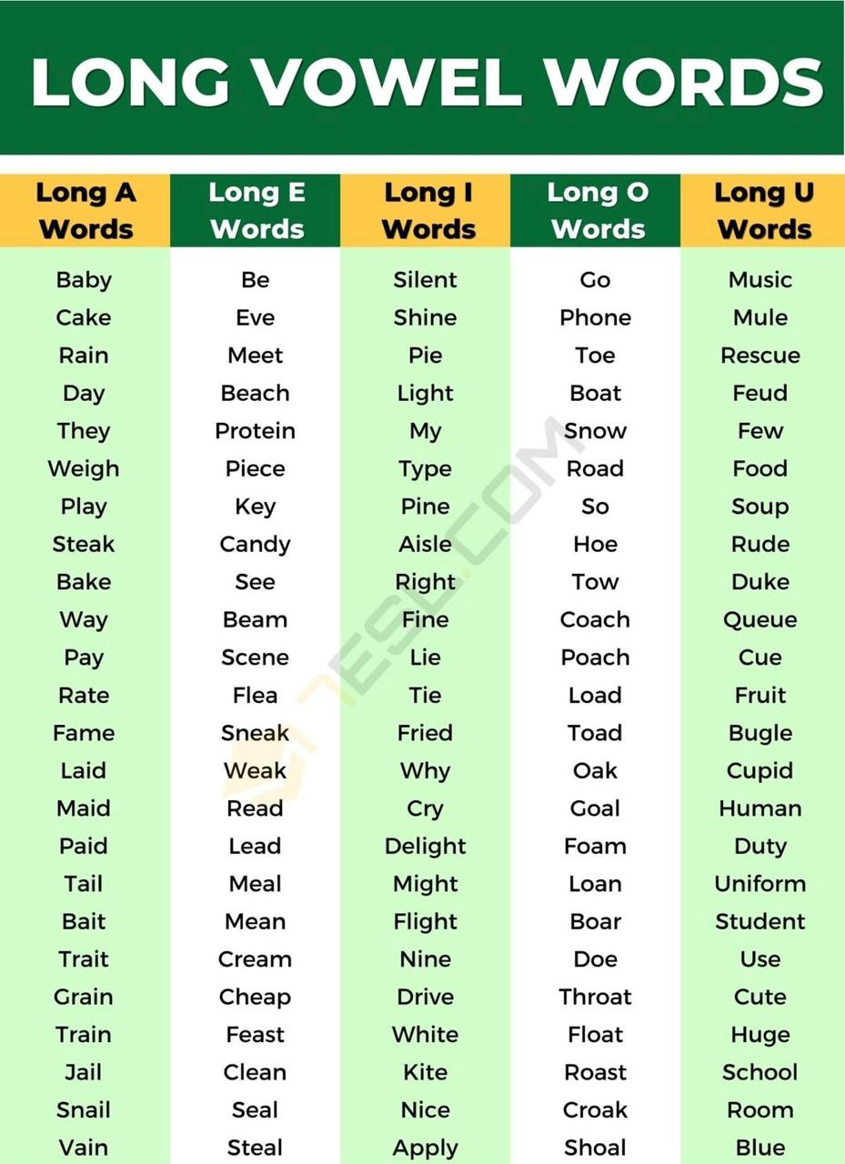

Slide 29
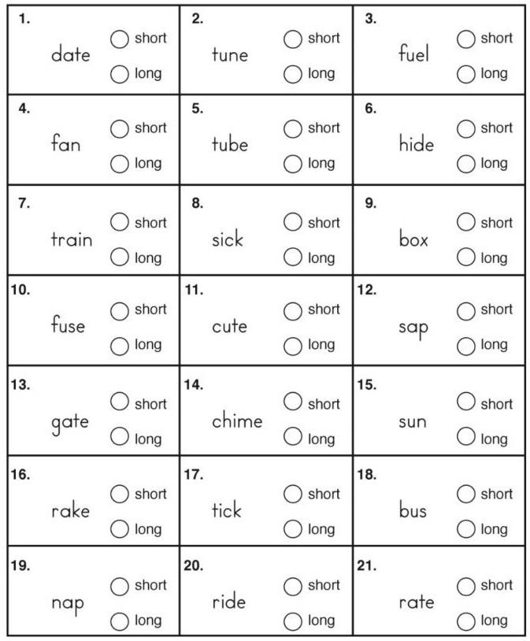
Let’s identify the vowel sound

Slide 30
Answer keys
Date Long ‘a’ sound
Tune Long ‘u’ sound
Fuel Long ‘u’ sound
Fan Short ‘a’ sound
Tube Long ‘u’ sound
Hide Long ‘i’ sound
Train Short ‘a’ sound long ‘i’ sound
Sick Short ‘i’ sound
Box Short ‘o’ sound
Fuse Long ‘u’ sound
cute Long ’u’ sound
Sap short ‘a’ sound
Gate Long ‘a’ sound
Chime Long ‘i’ sound
Sun short ‘u’ sound
Rake Long ‘a’ sound
Tick short ‘i’ sound
Bus short ‘u’ sound
Nap short ‘a’ sound
Ride long ‘i’ sound
Rate long ‘a ‘ sound

Slide 31
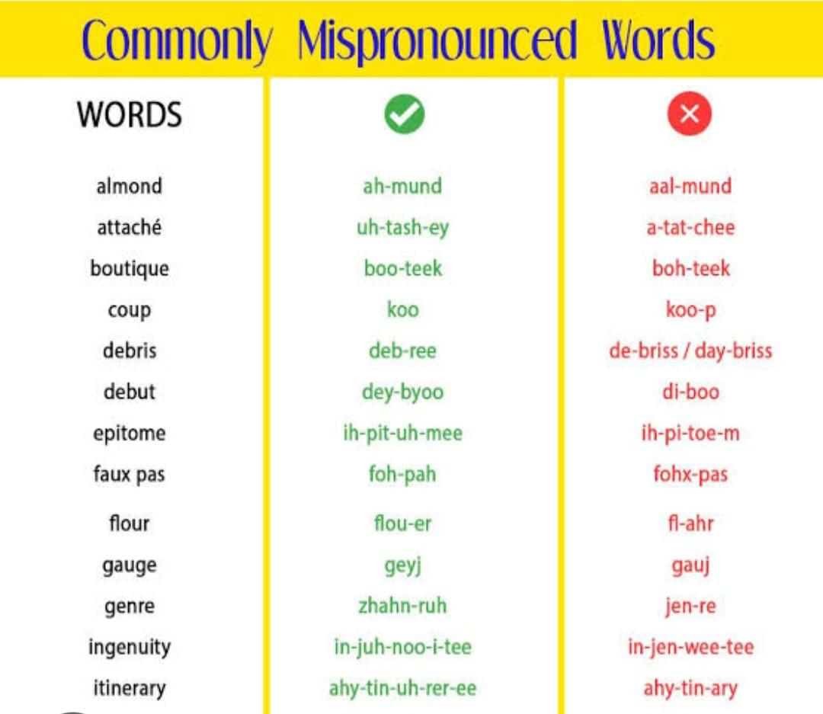

Slide 32
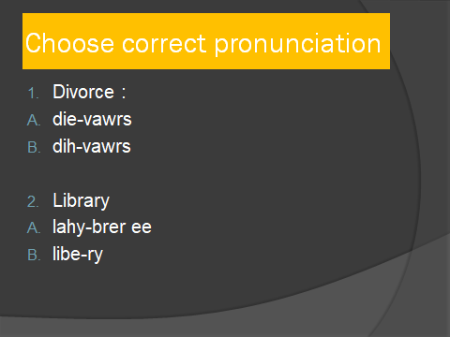

Slide 33

Expressive Elocution

Slide 34
What is Expressive Elocution?
Expressive elocution refers to the act of delivering a speech or presentation to an audience. It involves communicating information, ideas, or opinions to a group of people in a structured and deliberate manner.

Slide 35

Where to use elocution?
Business Presentations
Educational Settings
Public Relations and Marketing
Entertainment Industry
Motivational Speaking
Legal Profession
Healthcare etc.

Slide 36

Importance of elocution
Boosts Confidence
Critical Thinking
Leadership Skills
Career Advancement
Networking Opportunities
Influence and Persuasion

Slide 37

Let’s practice : Speak on the given topic:
The happiest day of my life

Slide 38


